Slide 1
Software DEVOLPMENT and Documentation

Slide 2
Project (25%): A comprehensive project where students document a sample software application, covering each SDLC phase.
Final Exam (75%)

Slide 3
Introduction
Reasons for software documentation
Types of software documentation
Ways to implement software documentation
Processes and “Good Ideas”

Slide 4
What is the Software documentation
is a written piece of text that is often accompanied by a software program. This makes the life of all the members associated with the project easier. It may contain anything from API documentation, build notes or just help content.
It is a very critical process in software development. It’s primarily an integral part of any computer code development method.
Moreover, computer code practitioners are a unit typically concerned with the worth, degree of usage, and quality of the actual documentation throughout the development and its maintenance throughout the total method.

Slide 5
Motivated by the requirements of Novatel opposition, a world-leading company developing package in support of worldwide navigation satellite system, and based mostly on the results of a former systematic mapping studies area unit aimed at a higher understanding of the usage and therefore the quality of varied technical documents throughout computer code development and their maintenance

Slide 6
For example, before the development of any software product requirements are documented which is called Software Requirement Specification (SRS). Requirement gathering is considered a stage of Software Development Life Cycle (SDLC).
Another example can be a user manual that a user refers to for installing, using, and providing maintenance to the software application/product.

Slide 7
Purpose of Documentation:
Due to the growing importance of computer code necessities, the method of crucial them needs to be effective to notice desired results. As to such determination of necessities is often beneath sure regulation and pointers that area unit core in getting a given goal.
These all imply that computer code necessities area unit expected to alter thanks to the ever ever-changing technology within the world.
However, the very fact that computer code information I’d obtained through development has to be modified within the wants of users and the transformation of the atmosphere area unit is inevitable.

Slide 8
What is more, computer code necessities ensure that there’s a verification and therefore the testing method, in conjunction with prototyping and conferences there are focus teams and observations?
For a software engineer reliable documentation is typically a should the presence of documentation helps keep track of all aspects of associate applications, and it improves the standard of wares, it’s the most focused area of unit development, maintenance, and information transfer to alternative developers.
Productive documentation can build info simply accessible, offer a restricted range of user entry purposes, facilitate new users to learn quickly, alter the merchandise and facilitate chopping out the price.

Slide 9
Importance of software documentation
For a programmer reliable documentation is always a must the presence keeps track of all aspects of an application and helps in keeping the software updated.

Slide 10
Principles of Software Documentation:
While writing or contributing into any software documentation, one must keep in mind the following set of 7-principles :

Slide 11
1. Write from reader’s point of view:
It’s important to keep in mind the targeted audience that will be learning, and working through the software’s documentation to understand and implement the fully functional robust software application and even the ones who will be learning for the purpose of using the software. So, while writing a documentation it becomes very crucial to use the simplest language & domain related specific languages and terminologies. The structure of the documentation should be organized in a clearly viewable, navigable and understandable format.
If there’s a lot of content, you can organize it in the glossary part at the end of the document.
List down synonyms, antonyms and difficult terminologies used.

Slide 12
2. Avoid unnecessary repetition:
While the idea of hyperlinking and backlinking may seem redundant at the moment, but it aids in avoiding the need of redundancy. The back-end database stores every piece of information as an individual unit and displays it in various different variety of context so redundancy at any point will not be maintainable and is considered a bad practice.

Slide 13
3. Avoid ambiguity:
Documentation contains a lot of information regarding the versatile functionalities of the software system, every part of it must be written with clear and precise knowledge while avoiding any conflicting information that might cause confusion to the reader. For example, if one terminology is used in different set of context than it must be explicitly defined what it means so to avoid any miscommunication. This aspect of the software documentation is very important to avoid any kind of conflicting knowledge between the stakeholders, developers and the maintainers.

Slide 14
4. Follow a certain standard organization:
In order to maintain the professionalism, accuracy, and precision of the document a certain set of principles must be followed taking reference from other software documentations that would aid in organizing and structuring the content of the documentation in a much productive and organized way.

Slide 15
5. Record a Rationale
Rationale contains a comprehensive understanding of why a certain design or development decision was made. This part of our documentation is written & maintained by the developer or the designer itself for justification and verification for later needs. Rationale can be mentioned in the start or the end of the document although typically, it’s in the start of the document.

Slide 16
6. Keep the documentation updated but to an extent
This principle applies to the maintainers of the documentation of the software, because updates are made to the software on frequent intervals. The updates may contain some bug fixes, new feature addition or previous functionality maintenance. The maintainer of the documentation must only add the valuable content and avoid anything that doesn’t fit and irrelevant for that particular time.

Slide 17
7. Review documentation
The documentation consists of too many web-pages collectively holding a large chunk of information that’s serving a sole purpose – educate and spread knowledge to anyone who is trying to understand or implement the software. While working with a lot of information it is important ta take feedback from senior architects and make any necessary changes aligning the documentation with its sole purpose depending on the type of documentation.

Slide 18
Advantages of software documentation
The presence of documentation helps in keeping the track of all aspects of an application and also improves the quality of the software product.
The main focus is based on the development, maintenance, and knowledge transfer to other developers.
Helps development teams during development.
Helps end-users in using the product.
Improves overall quality of software product
It cuts down duplicative work.
Makes easier to understand code.
Helps in establishing internal coordination in work.

Slide 19
Disadvantages of software documentation
The documenting code is time-consuming.
The software development process often takes place under time pressure, due to which many times the documentation updates don’t match the updated code.
The documentation has no influence on the performance of an application.
Documenting is not so fun, it’s sometimes boring to a certain extent.
The agile methodology encourages engineering groups to invariably concentrate on delivering prices to their customers. This key should be thought-about within the method of manufacturing computer code

Slide 20
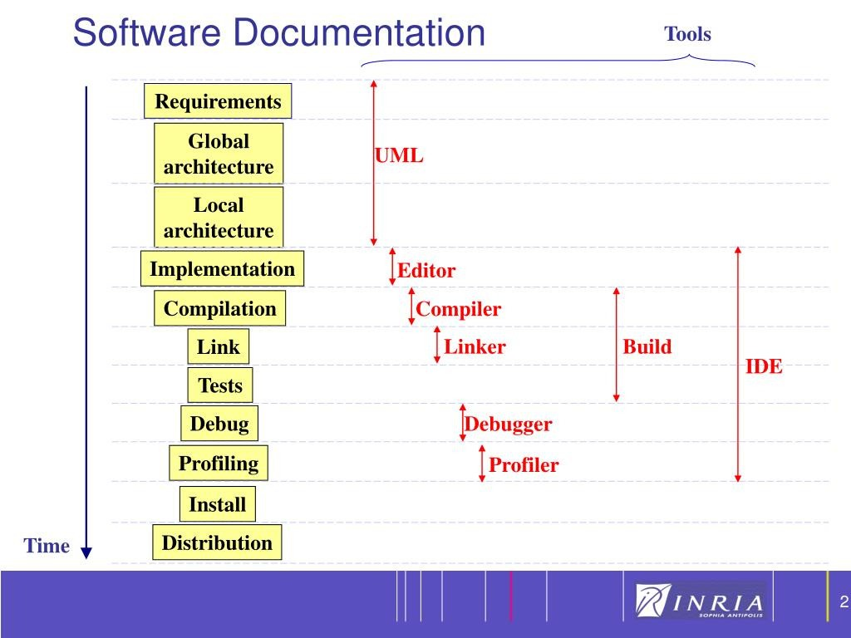

Slide 21


Slide 22
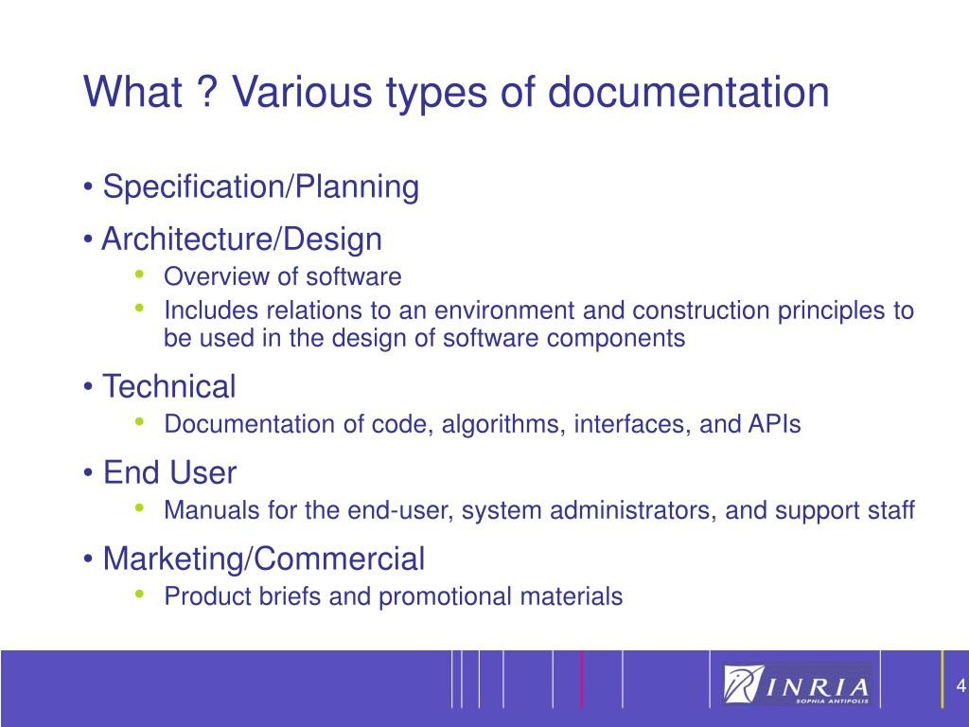

Slide 23
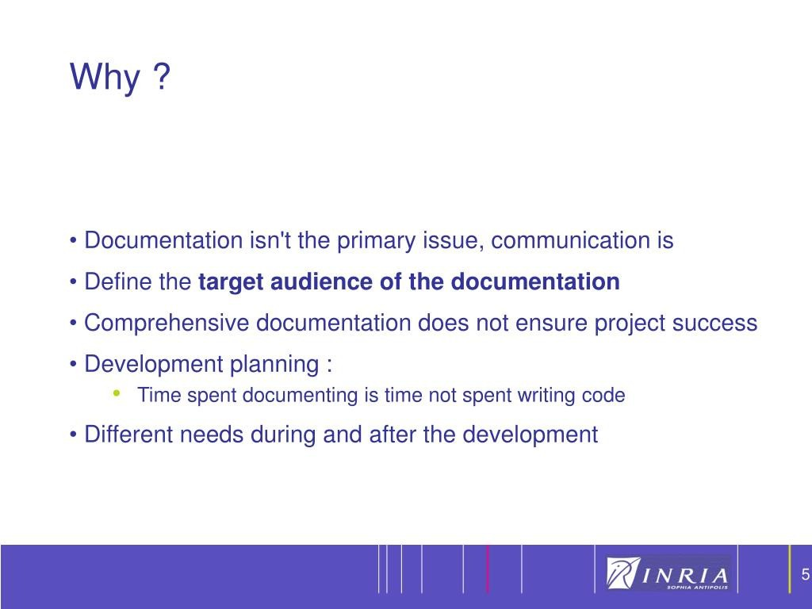

Slide 24
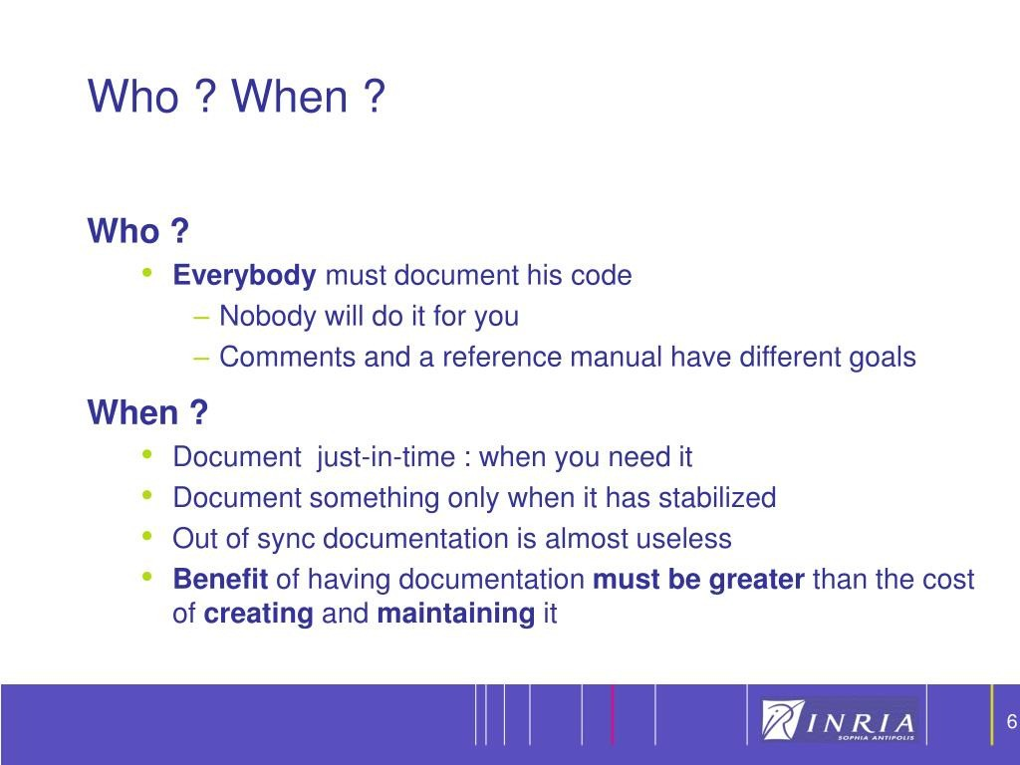

Slide 25
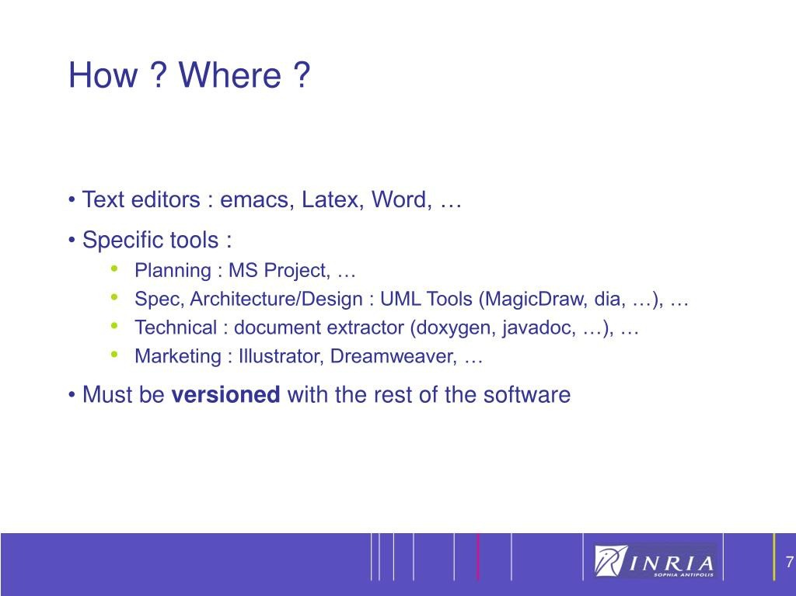

Slide 26
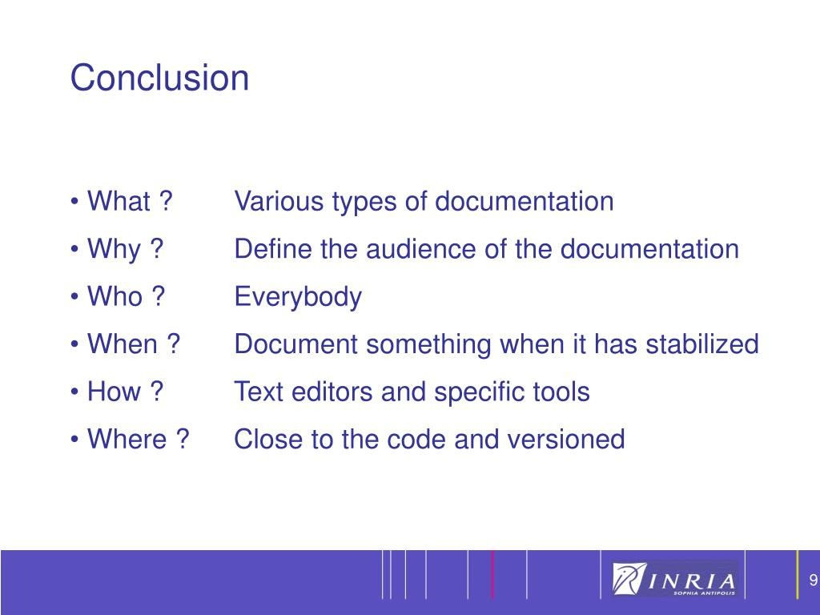

Slide 27
Documentation Requirements
General requirements of all software documentation
Should provide for communication among team members
Should act as an information repository to be used by maintenance engineers
Should provide enough information to management to allow them to perform all program management related activities
Should describe to users how to operate and administer the system

Slide 28
Documentation Requirements
In all software projects some amount of documentation should be created prior to any code being written
Design docs, etc.
Documentation should continue after the code has been completed
User’s manuals, etc.
The two main types of documentation created are Process and Product documents

Slide 29
Process Documentation
Used to record and track the development process
Planning documentation
Cost, Schedule, Funding tracking
Schedules
Standards
Etc.
This documentation is created to allow for successful management of a software product

Slide 30
Process Documentation
Has a relatively short lifespan
Only important to internal development process
Except in cases where the customer requires a view into this data
Some items, such as papers that describe design decisions should be extracted and moved into the product documentation category when they become implemented
Process documentation is produced so that the development of the system can be managed.

Slide 31
Process documentation falls into a number of categories:
1. Plans, estimates and schedules: These are documents produced by managers which are used to predict and to control the software process. 2. Reports: These are documents which report how resources were used during the process of development. 3. Standards: These are documents which set out how the process is to be implemented. These may be developed from organizational, national or international standards

Slide 32
4. Working papers: These are often the principal technical communication documents in a project. They record the ideas and thoughts of the engineers working on the project, are interim versions of product documentation, describe implementation strategies and set out problems which have been identified. They often, implicitly, record the rationale for design decisions.
5. Memos and electronic mail messages: These record the details of everyday communications between managers and development engineers.

Slide 33
The major characteristic of process documentation is that most of it becomes outdated. Plans may be drawn up on a weekly, fortnightly or monthly basis.
Progress will normally be reported weekly. Memos record thoughts, ideas and intentions which change. Although of interest to software historians, much of this process information is of little real use after it has gone out of date and there is not normally a need to preserve it after the system has been delivered. However, there are some process documents that can be useful as the software evolves in response to new requirements.

Slide 34
For example, test schedules are of value during software evolution as they act as a basis for re-planning the validation of system changes. Working papers which explain the reasons behind design decisions (design rationale) are also potentially valuable as they discuss design options and choices made. Access to this information helps avoid making changes which conflict with these original decisions. Ideally, of course, the design rationale should be extracted from the working papers and separately maintained. Unfortunately this hardly ever happens.

Slide 35
Product Documentation
Describes the delivered product
Product documentation is used after the system is operational but is also essential for management of the system development. The creation of a document, such as a system specification, may represent an important milestone in the software development process.
Must evolve with the development of the software product
Two main categories:
System Documentation
User Documentation

Slide 36
System Documentation
System documentation includes all of the documents describing the system itself from the requirements specification to the final acceptance test plan. Documents describing the design, implementation and testing of a system are essential if the program is to be understood and maintained. Like user documentation, it is important that system documentation is structured, with overviews leading the reader into more formal and detailed descriptions of each aspect of the system.
Examples:
Requirements Spec
Architectural Design
Detailed Design
Commented Source Code
Including output such as JavaDoc
Test Plans
Including test cases
V&V plan and results
List of Known Bugs

Slide 37
For large systems that are developed to a customer’s specification, the system documentation should include:
The requirements document and an associated rationale.
A document describing the system architecture.
For each program in the system, a description of the architecture of that program.
For each component in the system, a description of its functionality and interfaces.

Slide 38
Program source code listings. These should be commented where the comments should explain complex sections of code and provide a rationale for the coding method used.
Validation documents describing how each program is validated and how the validation information relates to the requirements.
A system maintenance guide which describes known problems with the system, describes which parts of the system are hardware and software dependent and which describes how evolution of the system has been taken into account in its design.

Slide 39
A common system maintenance problem is ensuring that all representations are kept in step when the system is changed. To help with this, the relationships and dependencies between documents and parts of documents should be recorded in a document management system as discussed in the final part of this paper.
For smaller systems and systems that are developed as software products, system documentation is usually less comprehensive. This is not necessarily a good thing but schedule pressures on developers mean that documents are simply never written or, if written, are not kept up to date. These pressures are sometimes inevitable but, in my view, at the very least you should always try to maintain a specification of the system, an architectural design document and the program source code.

Slide 40
Unfortunately, documentation maintenance is often neglected. Documentation may become out of step with its associated software, causing problems for both users and maintainers of the system. The natural tendency is to meet a deadline by modifying code with the intention of modifying other documents later.
Often, pressure of work means that this modification is continually set aside until finding what is to be changed becomes very difficult indeed. The best solution to this problem is to support document maintenance with software tools which record document relationships, remind software engineers when changes to one document affect another and record possible inconsistencies in the documentation. Such a system is described by Garg and Scacchi (1990).

Slide 41
User Documentation
Users of a system are not all the same. The producer of documentation must structure it to cater for different user tasks and different levels of expertise and experience. It is particularly important to distinguish between end-users and system administrators:
User Documentation has two main types
End User: use the software to assist with some task. This may be flying an aircraft, managing insurance policies, writing a book, etc. They want to know how the software can help them. They are not interested in computer or administration details.

Slide 42
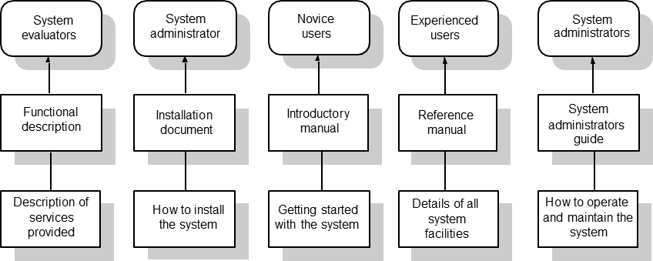
Figure 1: Different types of user documentation

Slide 43
System Administrator: are responsible for managing the software used by end-users. This may involve acting as an operator if the system is a large mainframe system, as a network manager is the system involves a network of workstations or as a technical guru who fixes end-users software problems and who liaises between users and the software supplier.
In some cases these are the same people
The target audience must be well understood!

Slide 44
Product Documentation
There are five important areas that should be documented for a formal release of a software application
These do not necessarily each have to have their own document, but the topics should be covered thoroughly
1. Functional Description of the Software: The functional description of the system outlines the system requirements and briefly describes the services provided. This document should provide an overview of the system. Users should be able to read this document with an introductory manual and decide if the system is what they need.

Slide 45
2. Installation Instructions: intended for system administrators. It should provide details of how to install the system in a particular environment. It should contain a description of the files making up the system and the minimal hardware configuration required. The permanent files which must be established, how to start the system and the configuration dependent files which must be changed to tailor the system to a particular host system should also be described. The use of automated installers for PC software has meant that some suppliers see this document as unnecessary. In fact, it is still required to help system managers discover and fix problems with the installation
3. Introductory Manual: should present an informal introduction to the system, describing its ‘normal’ usage. It should describe how to get started and how end-users might make use of the common system facilities. It should be liberally illustrated with examples. Inevitably beginners, whatever their background and experience, will make mistakes. Easily discovered information on how to recover from these mistakes and restart useful work should be an integral part of this document.

Slide 46
4. Reference Manual: should describe the system facilities and their usage, should provide a complete listing of error messages and should describe how to recover from detected errors. It should be complete. Formal descriptive techniques may be used. The style of the reference manual should not be unnecessarily pedantic and turgid, but completeness is more important than readability.
5. System Administrator’s Guide: should be provided for some types of system such as command and control systems. This should describe the messages generated when the system interacts with other systems and how to react to these messages. If system hardware is involved, it might also explain the operator’s task in maintaining that hardware. For example, it might describe how to clear faults in the system console, how to connect new peripherals, etc.

Slide 47
Document Structure
All documents for a given product should have a similar structure
A good reason for product standards
The IEEE Standard for User Documentation lists such a structure
It is a superset of what most documents need
The authors “best practices” are:
Put a cover page on all documents
Divide documents into chapters with sections and subsections
Add an index if there is lots of reference information
Add a glossary to define ambiguous terms

Slide 48
Standards
Standards play an important role in the development, maintenance and usefulness of documentation
Standards can act as a basis for quality documentation
But are not good enough on their own
Usually define high level content and organization
There are three types of documentation standards ->

Slide 49
1.Process Standards
Define the approach that is to be used when creating the documentation
Don’t actually define any of the content of the documents
Draft
Peer Reviews
Revise
Check

Slide 50
2. Product Standards
Goal is to have all documents created for a specific product attain a consistent structure and appearance
Can be based on organizational or contractually required standards
Four main types:
Documentation Identification Standards
Document Structure Standards
Document Presentation Standards
Document Update Standards

Slide 51
2. Product Standards
One caveat:
Documentation that will be viewed by end users should be created in a way that is best consumed and is most attractive to them
Internal development documentation generally does not meet this need

Slide 52
3. Interchange Standards
Deals with the creation of documents in a format that allows others to effectively use
PDF may be good for end users who don’t need to edit
Word may be good for text editing
Specialized CASE tools need to be considered
This is usually not a problem within a single organization, but when sharing data between organizations it can occur
This same problem is faced all the time during software integration
Notes:
Mention

Slide 53
Other Standards
IEEE
Has a published standard for user documentation
Provides a structure and superset of content areas
Many organizations probably won’t create documents that completely match the standard
Writing Style
Ten “best practices” when writing are provided
Author proposes that group edits of important documents should occur in a similar fashion to software walkthroughs

Slide 54
Online Documentation
Either internal to the application or Web based
Requires rethinking the presentation style since normal “paper” documentation approaches do not carry over well
Should act as a supplement to paper documentation
Biggest benefit of Web docs are that they are always current

Slide 55
Document Preparation
Covers the entire process of creating and formatting a document for publication
Author recommends using specialized (and separate) tools for creating and preparing documents
This is only important for user documentation
It is often important to have a professional writer or document publisher evaluate documents before publication to ensure they look good and will carry over to paper well

Slide 56
Document Storage
Author Recommends (in 2001)
File System to store the actual documents
Database to store references to the files with metadata to allow searching and referencing
Today it is probably better to use a content management systems
CVS or Subversion
Free and Open Source
Easy to setup and maintain

Slide 57
Conclusion
Good overview of documentation
Though most documentation “requirements” are based on contract requirements
Hard to cover things like that in a paper like this
Most of the content seemed to be referring to user documentation
Design and other similar docs (often times more graphical than textual) were overlooked

